Slide 1


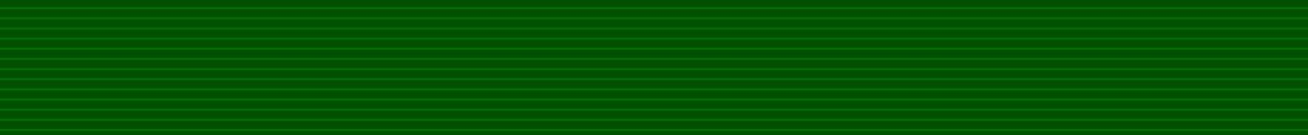
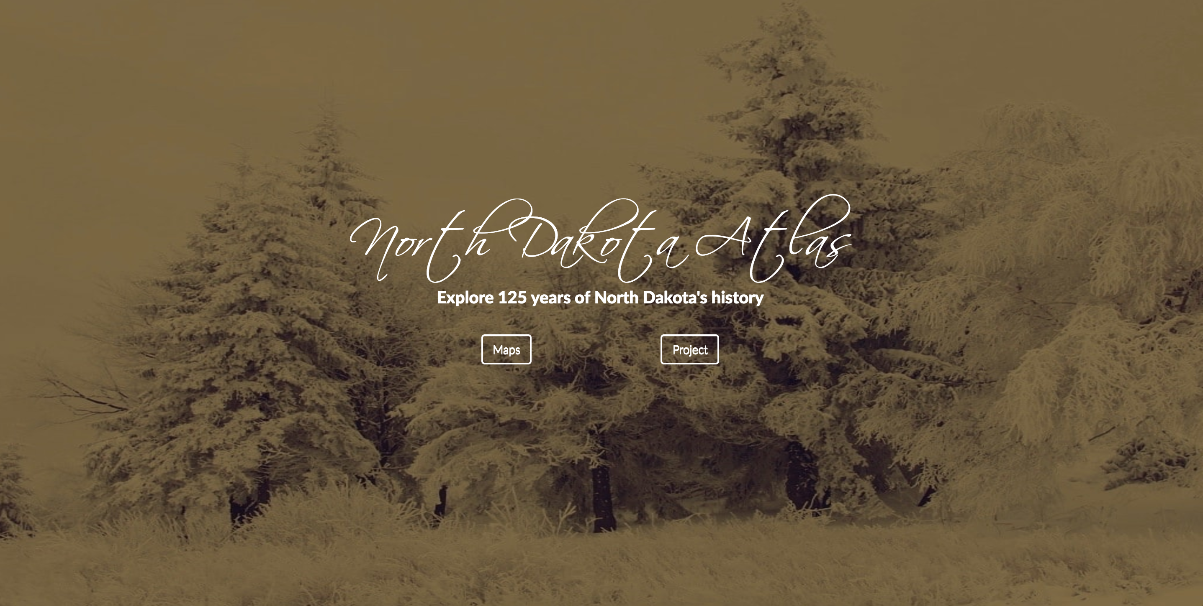
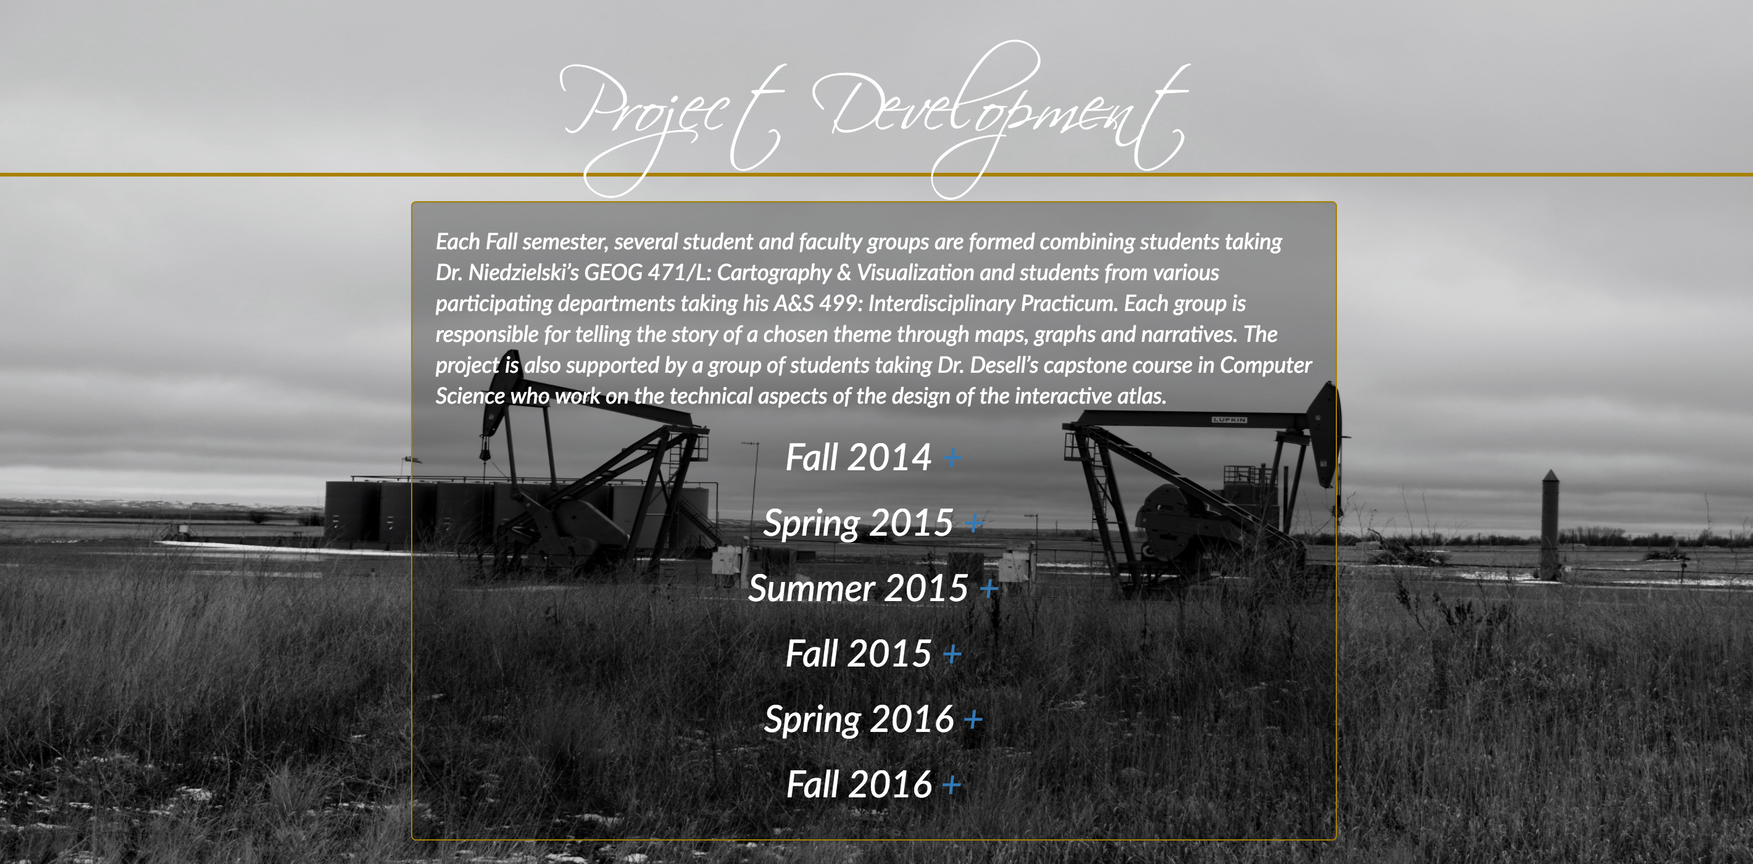
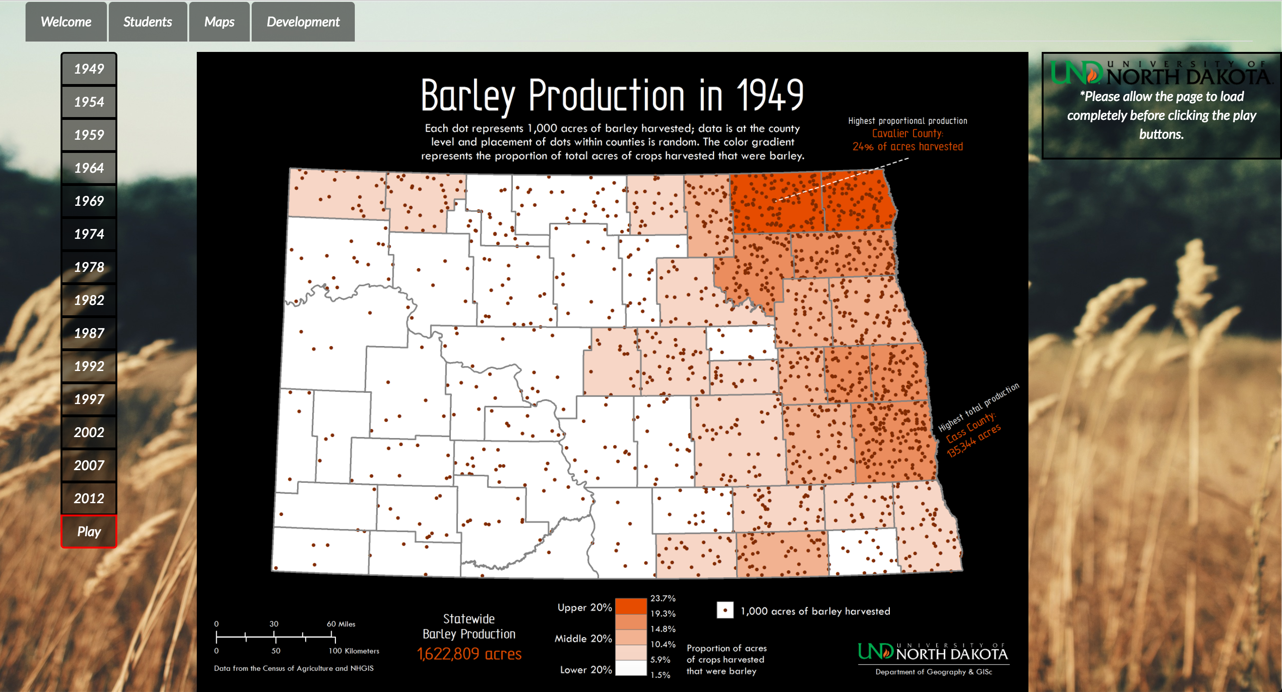
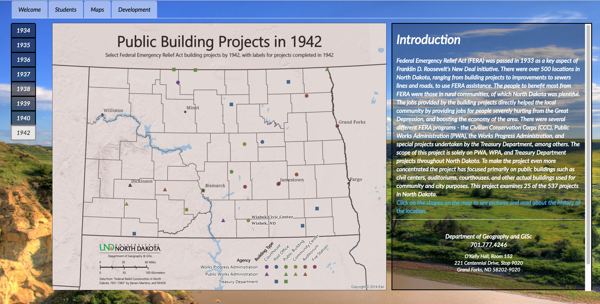
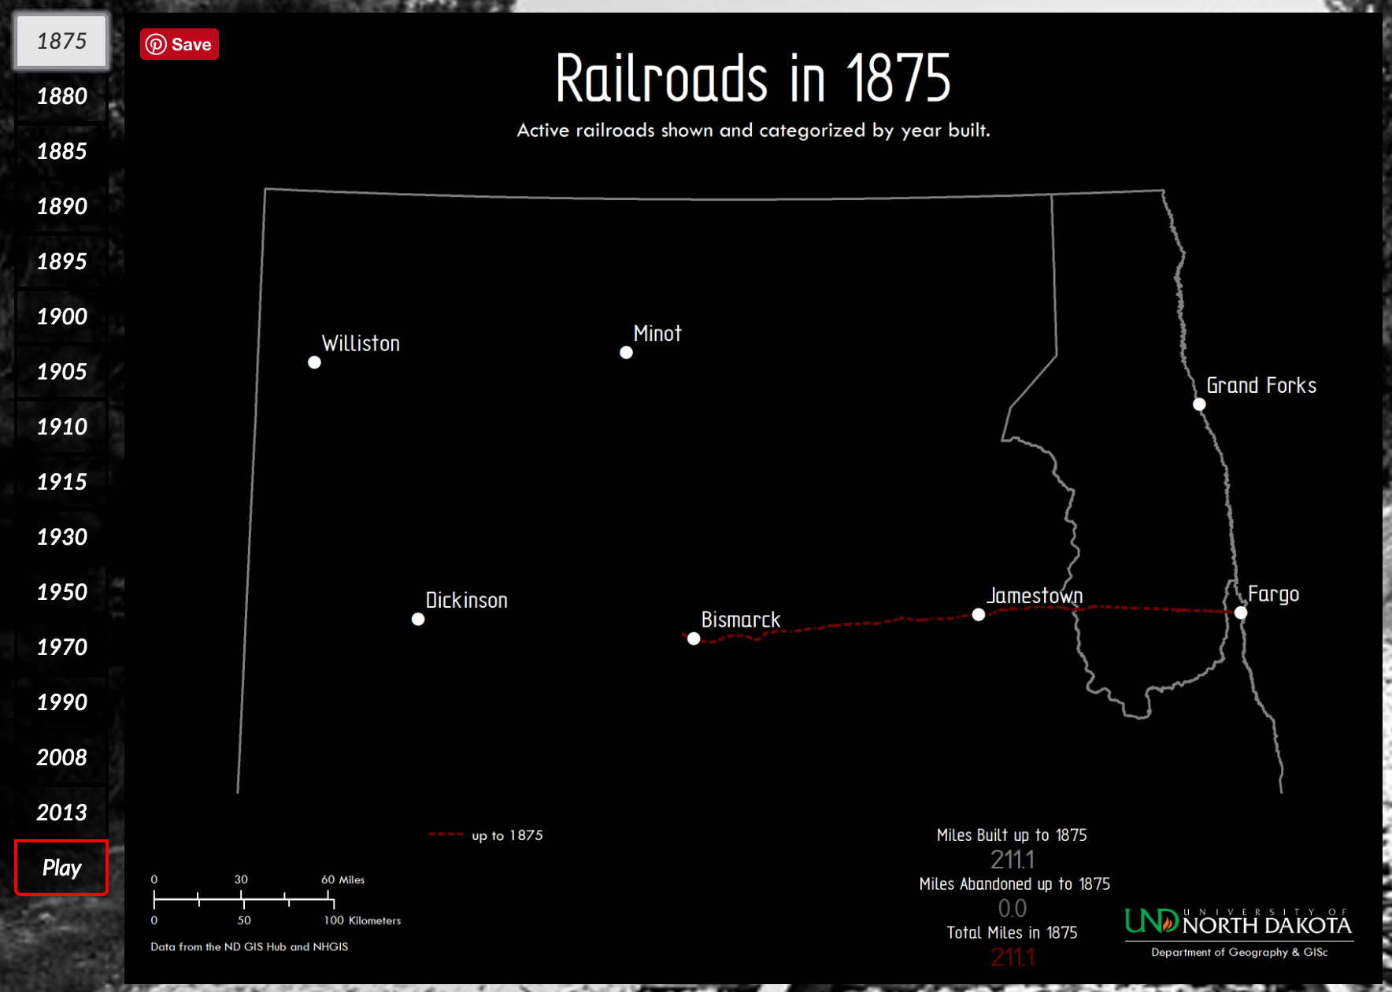
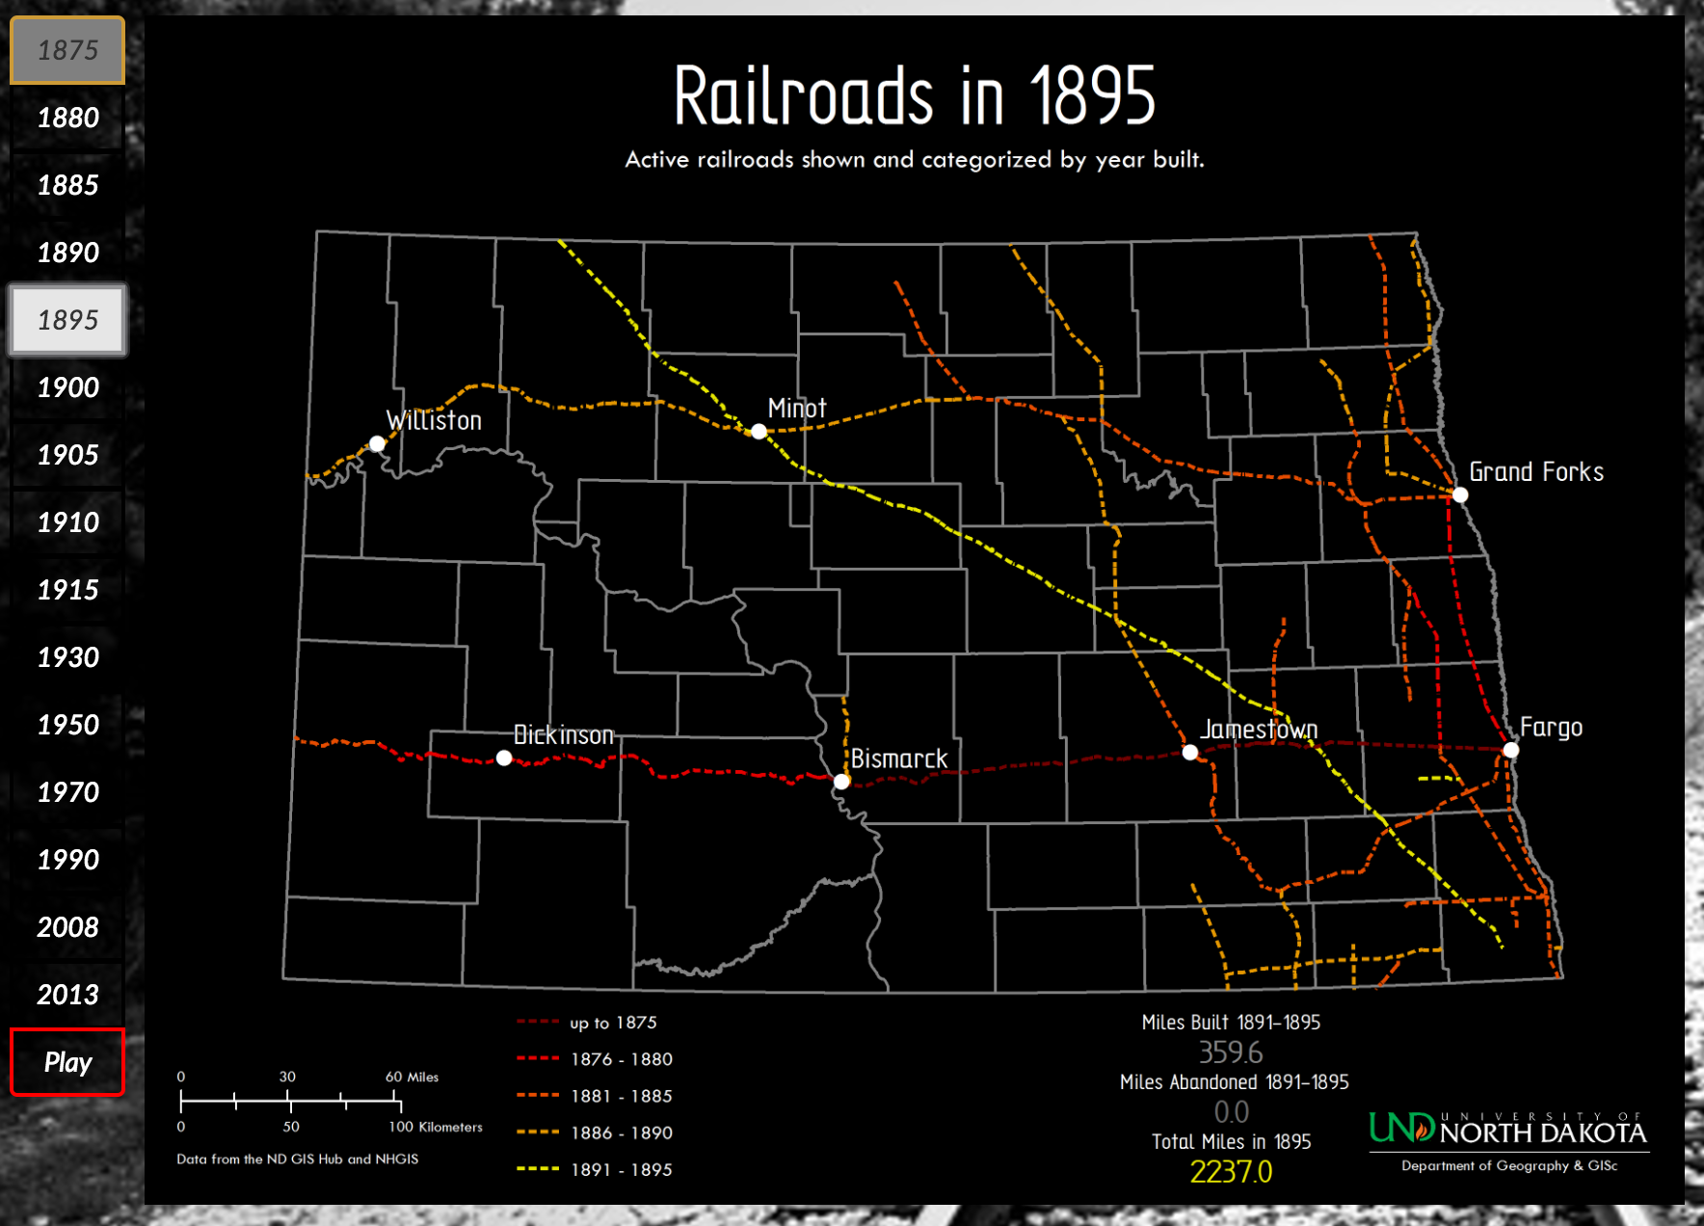
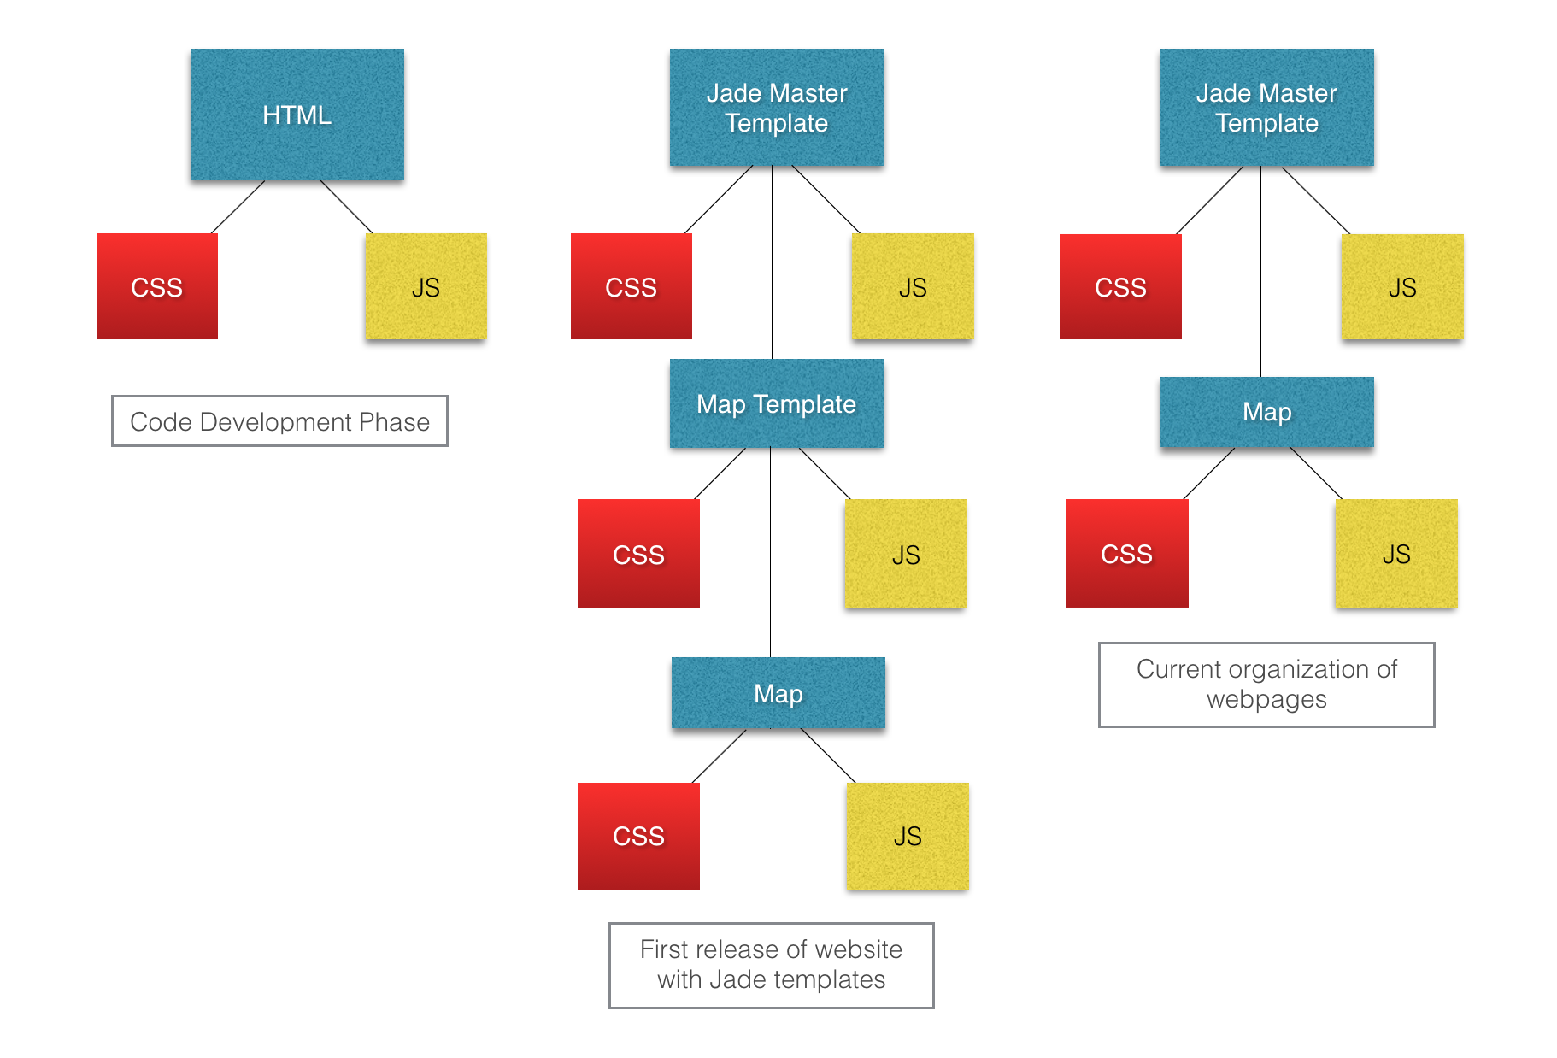
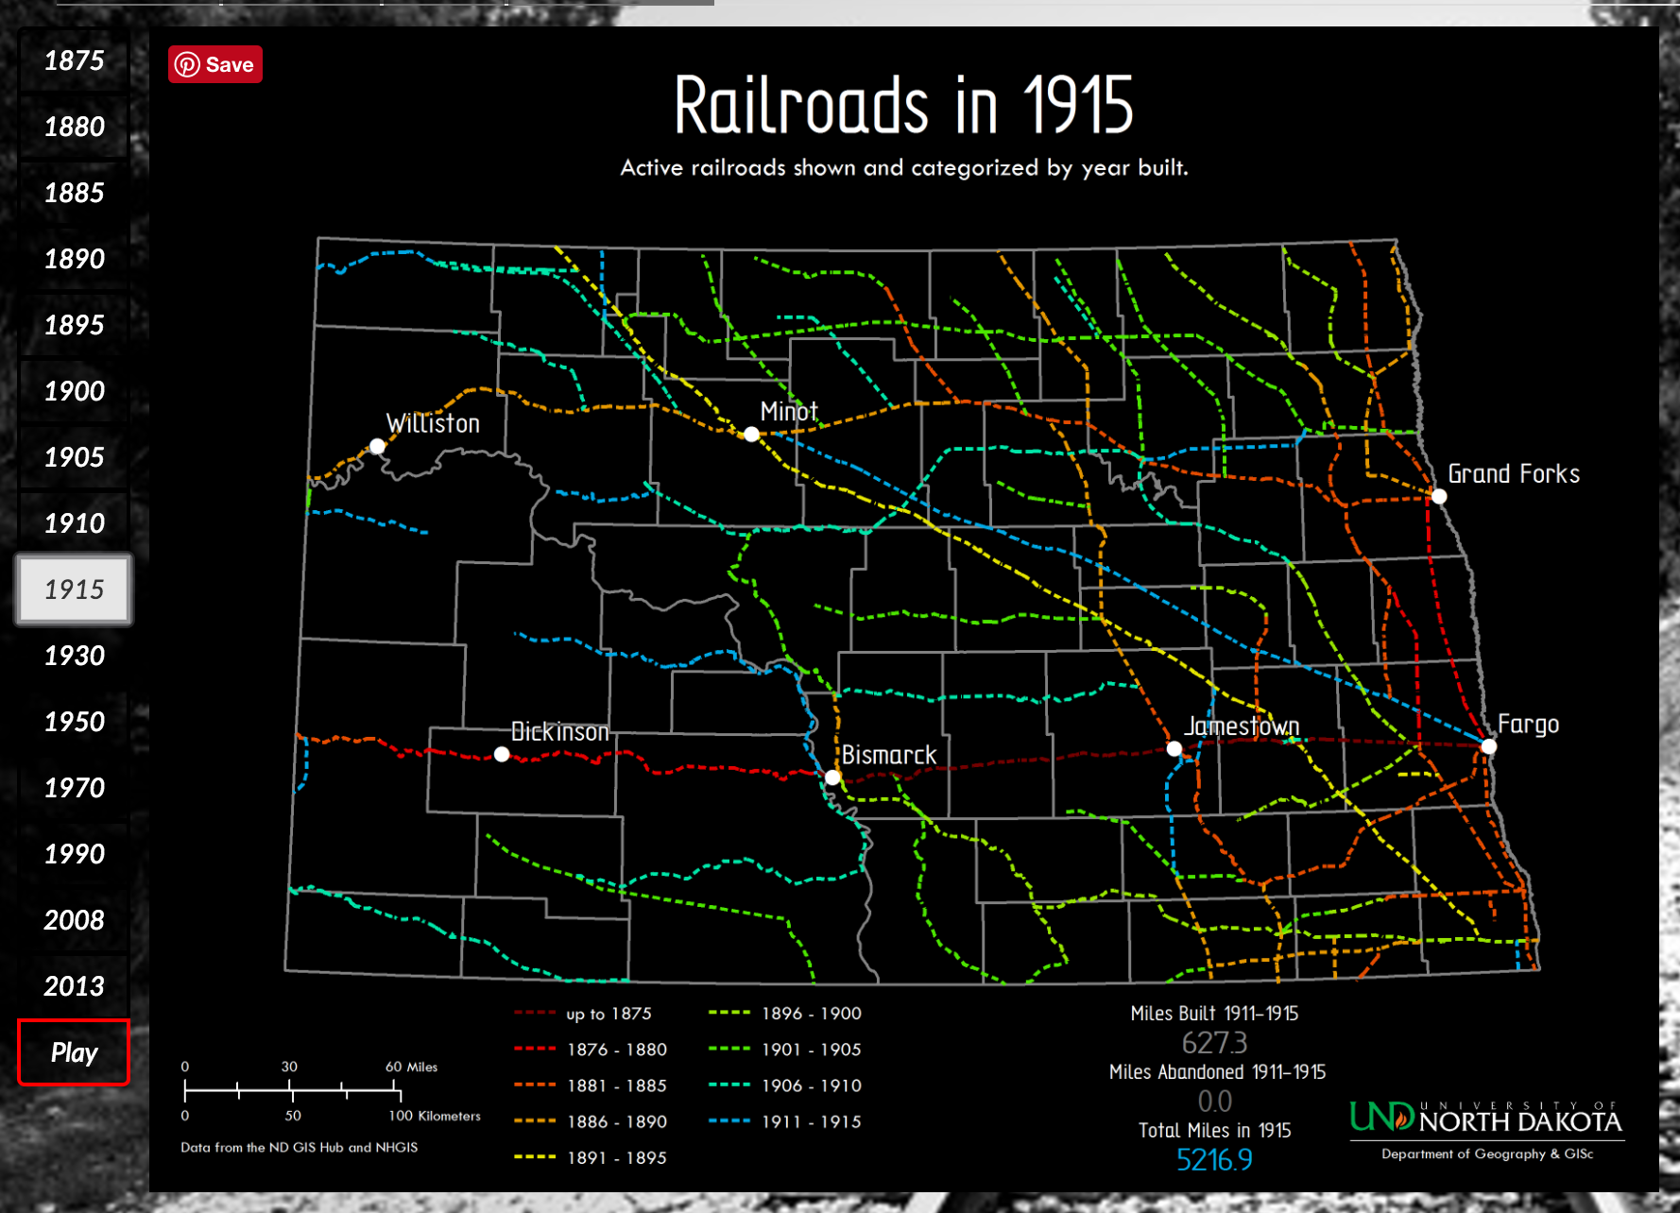
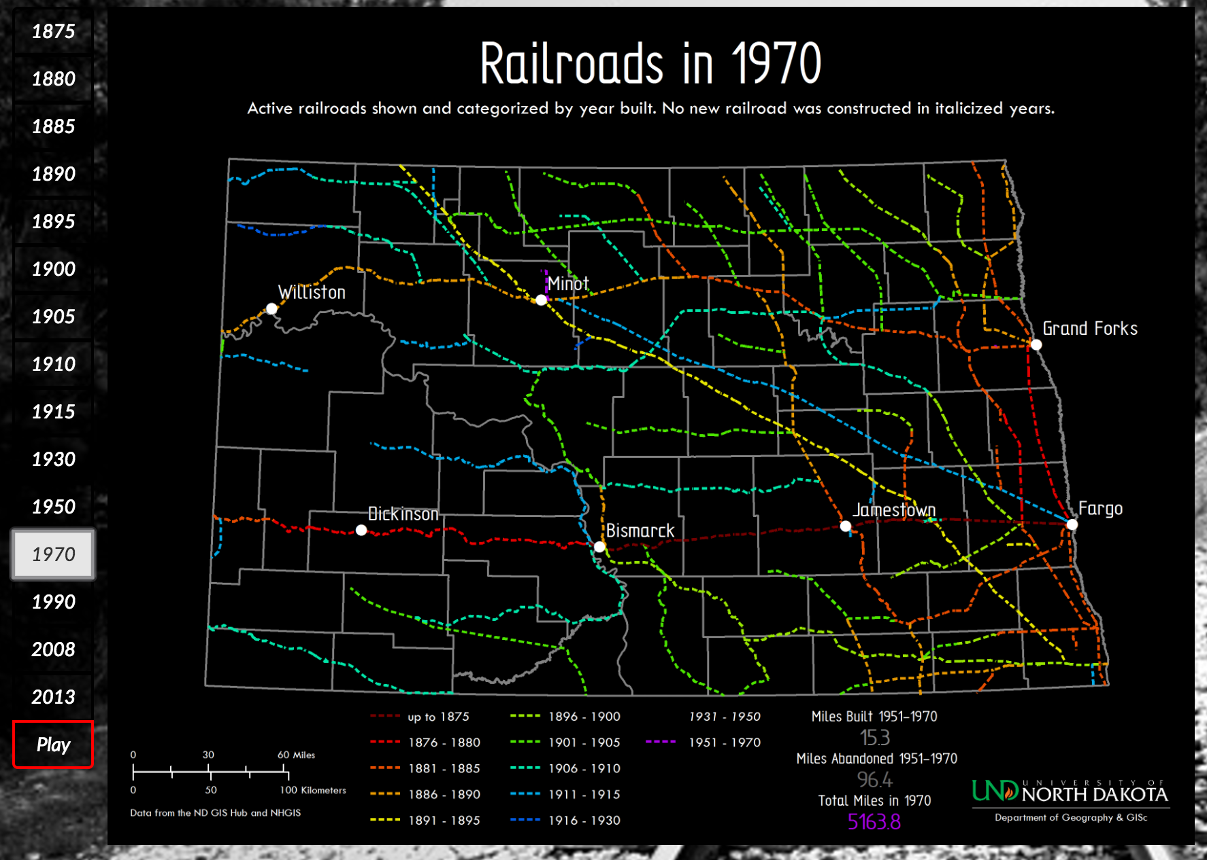
North Dakota Atlas
Lindsey Wingate, Marshall Mattingly, Dr. Michael Niedzielski, Dr. Travis Desell, Peter Brandt
Introduction
Results
The North Dakota Atlas website began as a senior project for another group a few years back. They set up a server and designed an interactive website, but it was never officially finished. Dr. Michael Niedzielski of the Geography Department wanted to see the project through but had some difficulties in the past with different groups of students coming in and out on the project. The goal this semester was to overhaul the entire website with new graphics, interactive maps, and to give it a clean, finished look.
The North Dakota Atlas redesign project was a success. The webpage is simple, modern, and a great resource for anyone studying North Dakota’s history. As the buttons are clicked along the side, you can see the changes over time. Visit ndatlas.und.edu to check it out!
Landing Page
History behind the maps, research, and student work.
The Public Building Projects maps are interactive. They were designed as image maps (simple HTML). At any time, the user can click on one of the shapes and a description and picture will appear in the narrative box to the right. This design is much simpler than the original maps on the Atlas.
I originally wanted the map to change dynamically with the page, but image maps require static points to create the links.
Methods
The first drafts of the project were designed (HTML, CSS) and displayed on the Citizen Science Grid until a local server was set up on my machine. I had almost weekly meetings with Dr. Niedzielski at the beginning of the semester to make sure he approved of the web designs.
After the first final drafts were complete, they were pushed to the live website. The HTML pages were translated into Jade templates, which was time consuming and took a few releases to get right. Below is a diagram describing the different releases and improvements over time.
The project was split into two phases. The first phase consisted of getting the new website live. The second phase involved perfecting the site and adding an interactive map.
The Barley Production Map is an example of a map display without a narrative. The map and buttons are centered and the map changes size dynamically depending on the screen size.
Acknowledgements
The Railroads maps are my favorite maps. As you click the play button you can watch the railroads cross through North Dakota during the great railroad building years. After the 70’s, the railroads slowed a few were abandoned, but trains are still a major mode of transportation through the state (as any UND student getting stuck at an intersection can attest).
The fantastic maps in the North Dakota Atlas were created based on research from UND students in the humanities departments (mainly the Geography department) and designed by Peter Brandt.
Thanks goes to Dr. Travis Desell and Marshall Mattingly, my technical advisors on this project. Marshall had worked on the site before and was extremely helpful when it came to getting the server working and all the web pages live.
Future Work
Although the Atlas is fully functional on laptop or desktop computers, a new application could be designed for tablets and smart phones. The Public Building interactive map is currently a static page that could be made dynamic. Improvements could be made on the loading times for all the maps and backgrounds.

